Slide 1
Radiological and Nuclear Threats
Robert Hillaire, Ph.D., PE ME
Exploratory Systems Technologies Department
Sandia National Laboratories, Livermore

Slide 2
Radiological Threat | Nuclear Threat
Radiological
Formal Name
  Radiological Dispersal Device
Also Known As
  Dirty Bomb
Nature of Damage
  Contamination
Nuclear
Formal Names
  Nuclear Weapon
  Improvised Nuclear Device
Also Known As
  Atomic Bomb
  A-Bomb
  Thermo-nuclear Bomb
Nature of Damage
  Blast
  Radiation
  Thermal
  Contamination-fallout

Slide 3


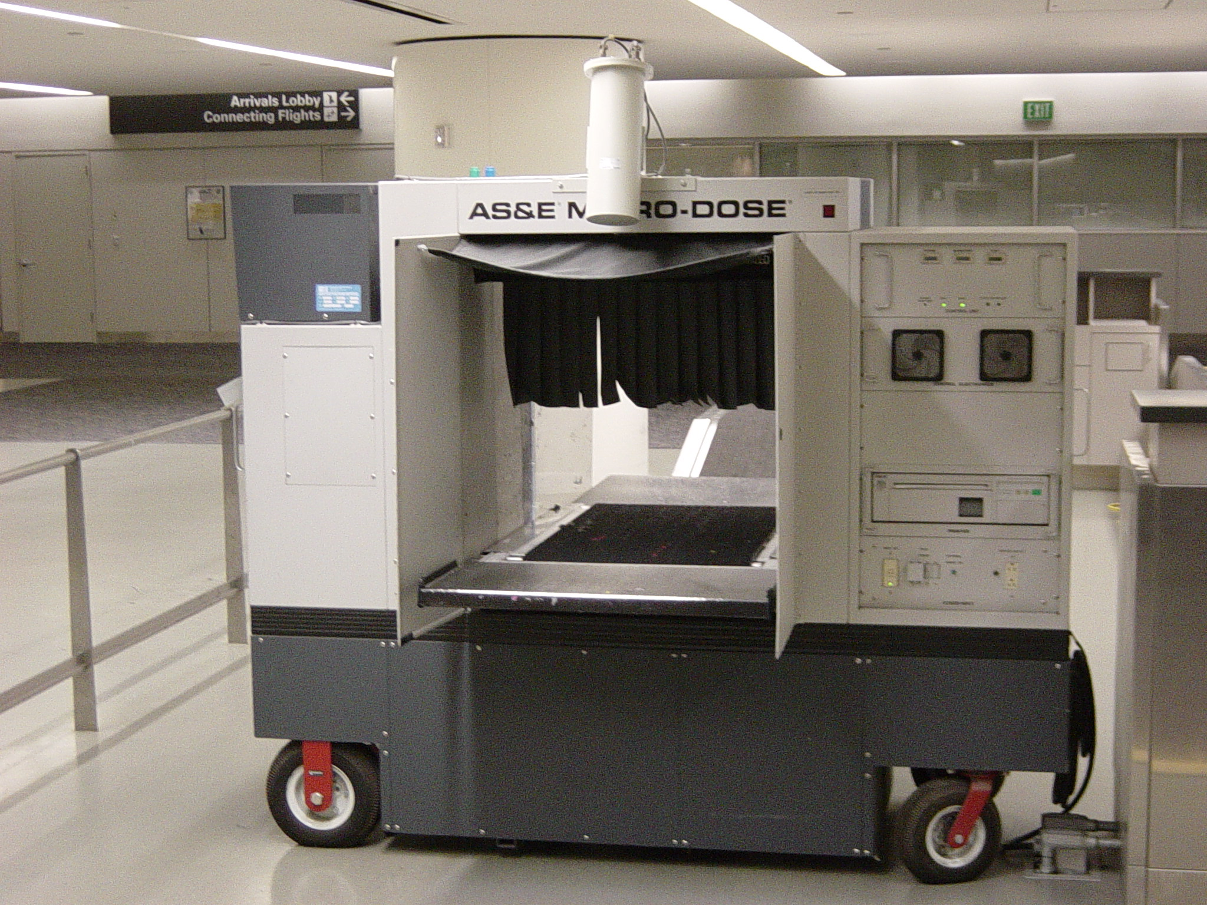
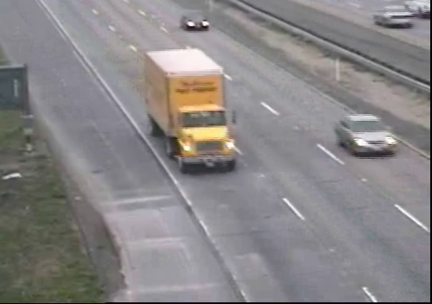
Radiological Dispersal Device
Physical Signatures
  Can be as small as an envelope or as big as a truck
    A person can carry one
    RDD material can be found in special equipment
  Can be powder, solid metal, or liquid solution
  Can be dispersed mechanically or explosively

Slide 4
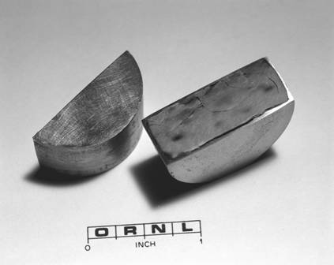
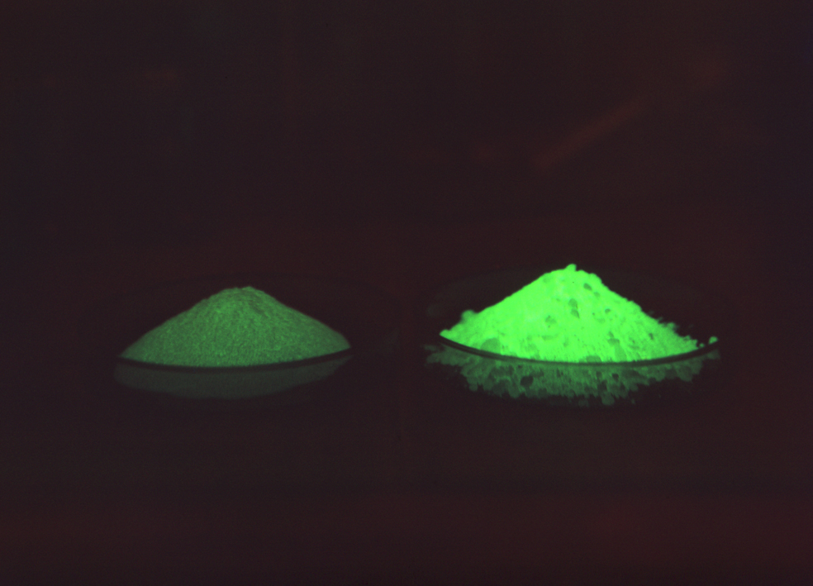
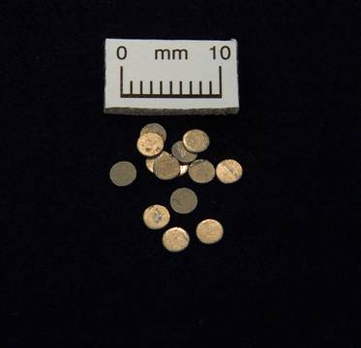
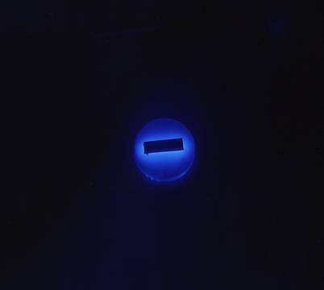
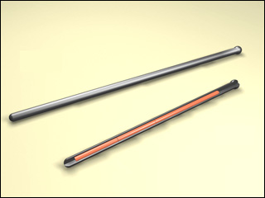
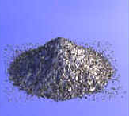
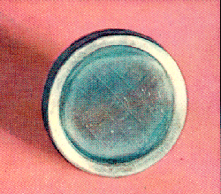
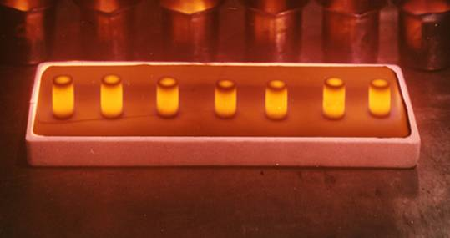
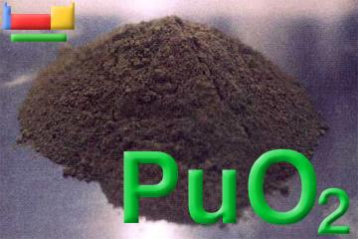
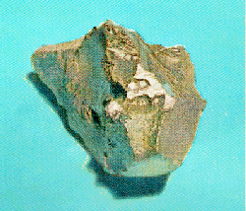
Radiological Materials
⁹⁰Sr
²⁵²Cf
¹³⁷Cs
¹⁹²Ir
⁶⁰Co
²⁴¹Am
²¹⁰Po
²⁴⁴Cm
curium
²³⁹Pu
²³⁸Pu
polonium
http://www.webelements.com

Slide 5
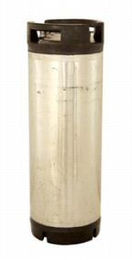
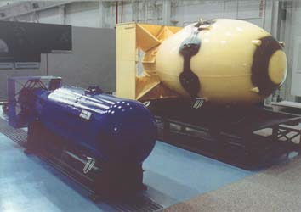

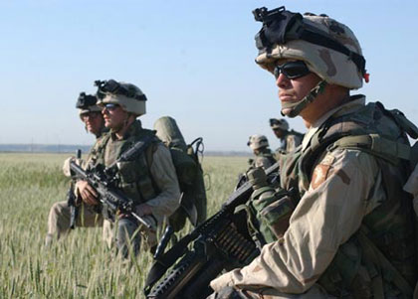
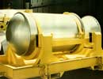
Nuclear Weapon
Physical Signatures
  Can be as small as a 5-gal keg or as big as a truck
    Typically heavy - a person would prefer to use a hand cart or vehicle to transport
    A shielded weapon will be quite heavy - vehicle may be required to transport
  Generally looks cylindrical or spherical
  All or part of the weapon should be opaque to x-ray

Slide 6
Ionizing Radiation Signatures
Radiation that possesses enough energy to cause ionization in the atoms with which it interacts
  alfa
    Large atomic particle that only travels 1-2 inches and will not penetrate skin
  beta
    Small atomic particle that can travel a few meters in air and can be shielded by plastic, glass, or wood
  gamma
    Photon (light) which can travel tens of meters in air which can be shielded by lead, steel, or concrete
  neutron
    Atomic particle that can travel tens of meters in air and which can be shielded by several inches/feet of water or polyethylene

Slide 7
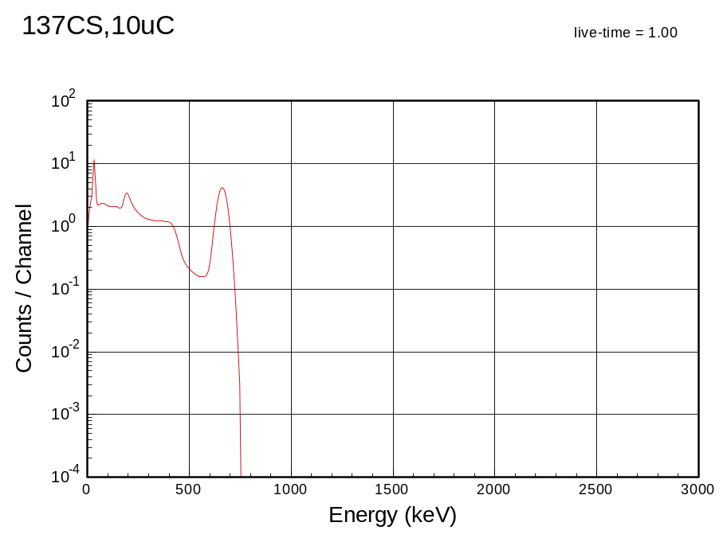
Gamma Radiation Signatures
RDD
Radioactive Emissions
Radiopharmaceutical
NORM
Industrial
Nuclear
NORM: Normally Occurring Radioactive Material

Slide 8
Threat Assessment
Radiological and Nuclear threats come in all shapes and sizes
Radiological and Nuclear threats can have many attack vectors
The radiation from radiological and nuclear threats have a large range and can be lower than some benign sources
Technology (sensors) alone will not solve the problem
  Good people, procedures, and policy must work together with technology
  Intel and special-ops are very helpful
  No single line of defense is perfect: multiple lines of defense are prudent:

